Slide 1

Web scraping to gain company insights
04/07/24

Slide 2
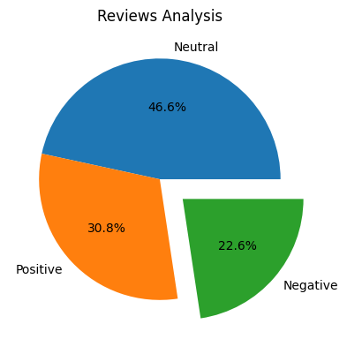
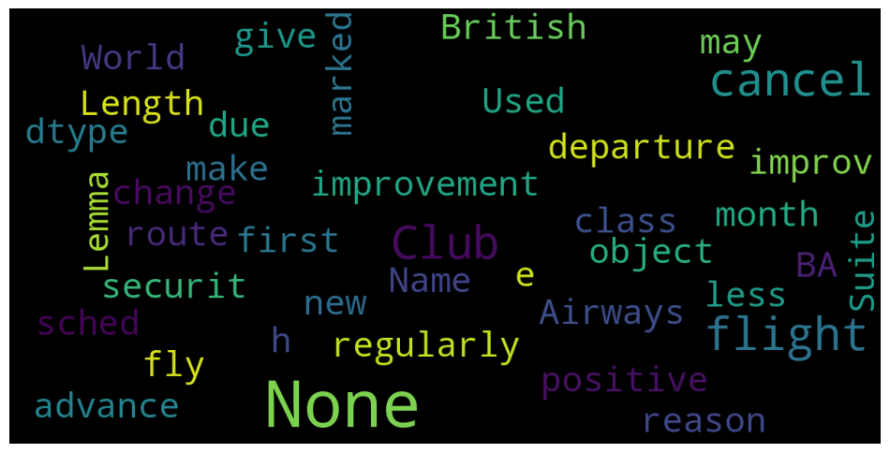
INSIGHTS FROM CUSTOMER REVIEWS
From cleaning 1000 reviews given by the customers, we obtained
Positive Reviews - 1176
Negative Reviews - 864
Neutral Reviews – 1780
Word cloud of keywords used in reviews

